Slide 1
HudsonAlpha BioTrain Computational Bootcamp
James Lawlor
Computational Biologist, Greg Cooper’s Lab
HudsonAlpha Institute for Biotechnology
June 03, 2019

Slide 2
Computer Setup
https://james-lawlor.github.io/biotrain-2019/
Setup Bash
(Windows) Download Git BASH http://www.gitforwindows.org
(Mac/Linux) Included. Open the “Terminal” application.
Get data-shell.zip from SW Carpentry http://swcarpentry.github.io/shell-novice/setup.html
Install R https://cran.rstudio.com/
Install RStudio Desktop https://www.rstudio.com/products/rstudio/download/#download
Download r-novice-inflammation data

Slide 3
Morning Agenda
What is Computational Biology?
Computational Biology in the Cooper Lab
Bootcamp Intro
Goals
Helpers & Post-Its
Why learn Unix & R?
Unix Fundamentals
Introducing the Shell
Navigating Files and Directories
Working With Files and Directories
Pipes, Filters, and Loops (brief overview of advanced topics)
Aside: Accessing the HudsonAlpha Compute Cluster
Keeping a Computational Lab Notebook and Getting Programming Help
Lunch!

Slide 4
Afternoon Agenda
Computational Biology Examples in the Myers Lab
Programming with R
Analyzing Biology Data
Writing Functions
Using For Loops to Analyze Multiple Data Sets
Continued Learning: Where to go next?

Slide 5
Introduction to Biology with Computers
James Lawlor & Bryan Moyers

Slide 6
What is computational biology?
“Computational biology and bioinformatics is an interdisciplinary field that develops and applies computational methods to analyze large collections of biological data, such as genetic sequences, cell populations or protein samples, to make new predictions or discover new biology.” -- Nature.com

Slide 7
In other words…
Use computational tools
Programming
Mathematical models & machine learning
Databases
Physics simulations
To analyze huge sets of data
Genome sequencing
Protein modeling
And answer biological questions
How does this gene work?
Does this disease have a genetic pattern?
How are these species related?
What makes a liver cell different from a brain cell?

Slide 8
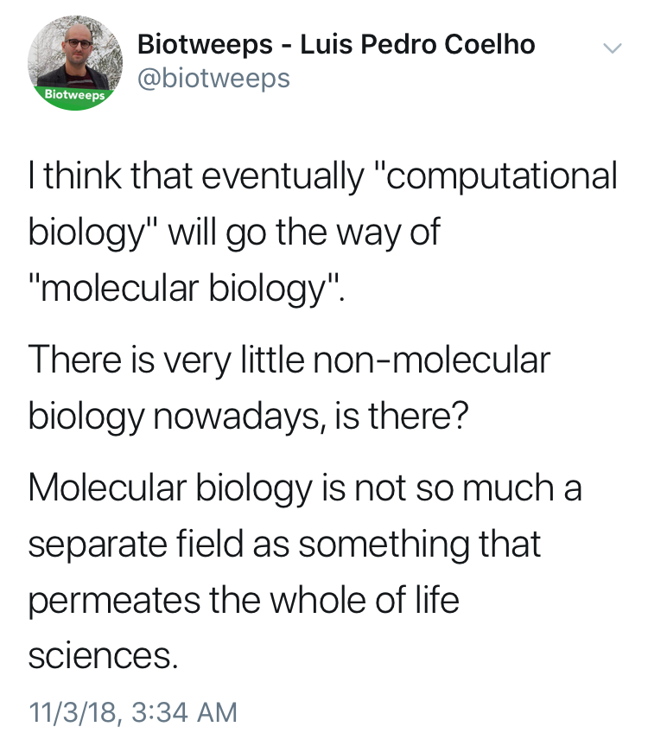

Slide 9
Terminology
The terms “bioinformatics” and “computational biology” are often used interchangeably:
Bioinformatics: Software tools, databases, visualization methods
Computational Biology: Data analysis, algorithm development, mathematical modeling
Other terms for the intersection of biology / math / computer science:
Data Science, Systems Biology, Statistical Biology, Biostatistics, Genomics (implicit), _____omics, Clinical Informatics, etc…

Slide 10
The bottom line:
Computational skills are increasingly critical for biology & many other fields
Hands-on experience is a huge first step
Notes:
Being able to say “I’ve done that before” is huge, even if you don’t remember a lot of it or didn’t feel like you were good at it.

Slide 11
Bryan’s intro to comp bio

Slide 12


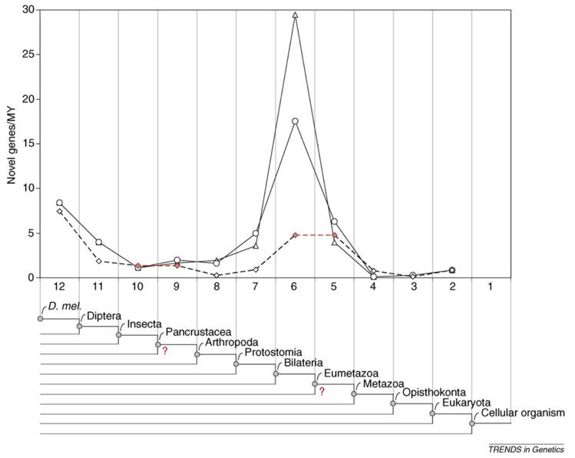

About Bryan Moyers
B.S. Biological Sciences, B.A. Psychology, Purdue University
PhD Bioinformatics, M.A. Applied Statistics, University of Michigan
Graduate thesis: On Gene Age, Gene Origins, and Evolutionary Trends
Notes:
A little about me. I went to Purdue university for my undergrad. Instead of studying Engineering like my entire family told me to, I wound up with dual degrees in Biology and Psychology.
I went on to the University of Michigan for grad school, where I also did not study Engineering like my entire family told me to. Instead, I earned a masters in statistics and a PhD in bioinformatics. My thesis work was in a lab that studied molecular evolution. My thesis was on a method that determined the age of genes, and its limitations.

Slide 13
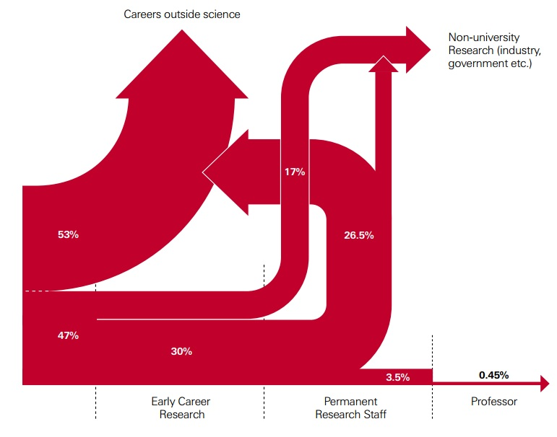
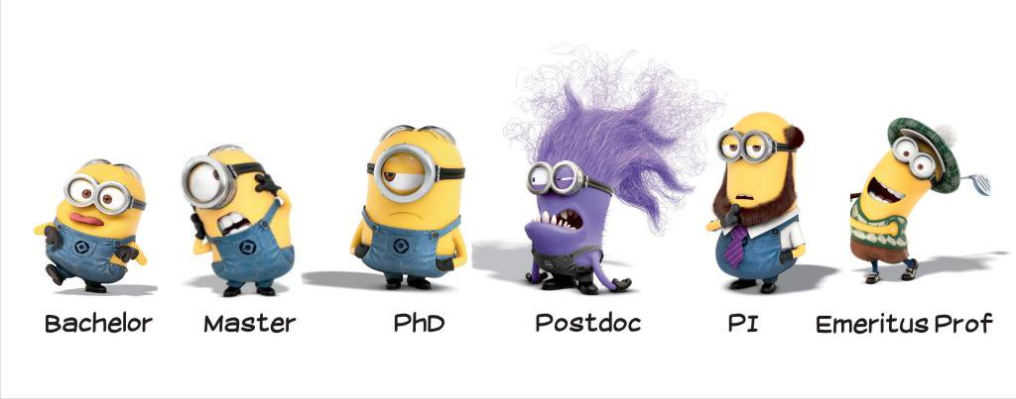
Postdoctoral Fellow and Beyond
HudsonAlpha Institute for Biotechnology, 2017-Present
Computational and Statistical analysis of genomic data for gene regulation.
Analysis of genomic variants in disease.
http://blogs.nature.com/naturejobs/2014/10/03/the-postdoc-decision/
Notes:
Since completing my PhD, I’ve been working here at HudsonAlpha as a postdoc, which is this horrid little purple creature here. I’m applying the skills that I learned in grad school to different research problems, specifically in gene regulation and genomic variants in disease. Now, apparently, my next step is supposed to be a nice distinguished fellow with a beard. But the problem is, I can’t grow a beard. So I’m probably not going to become a Professor. So, as a matter of making it clear to everyone, there are tons of careers outside of being a professor– and that’s actually a relatively common way of doing things. So, I imagine that many of you are planning on going to grad school, and I just wanted to point out that it’s worth talking to your mentors about your career trajectory.

Slide 14
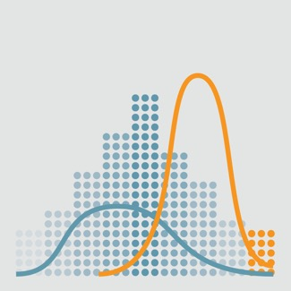
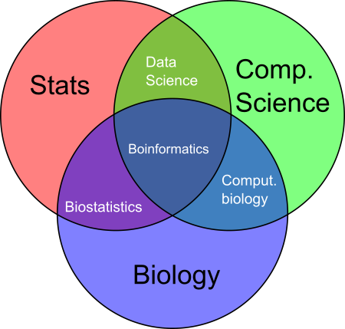
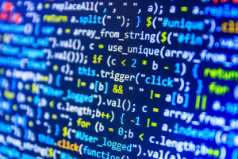
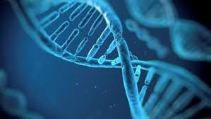
What is Bioinformatics?
“The science of collecting and analyzing complex biological data such as genetic codes.”
Day-to-day, bioinformatics is mostly coding, statistical analysis of biological data, and data visualization.
Work with biological data and other biologists to:
1) form conclusions
2) make new predictions / hypotheses to be tested
3) code computational tools for the biological community.
Notes:
James has already talked about this a bit, but I wanted to give another view of what bioinformatics is and why it’s important.
An official definition is quoted right here. But day-to-day, bioinformatics is mostly coding. These are really important functions! They help you form conclusions about experiments. They help you to propose new experiments. And, very often, they’ll help you produce tools that are useful across the biological community.

Slide 15
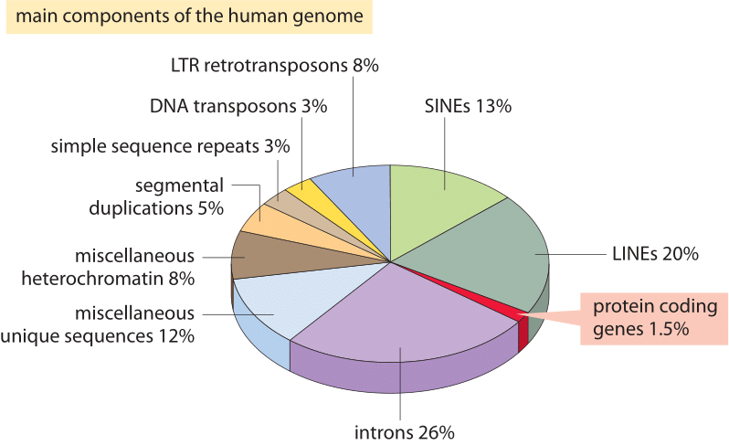
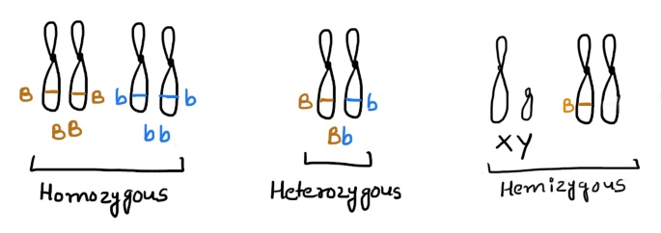
Why Bioinformatics?
Let’s take a look at a single human genome…
~3 billion nucleotides. Two copies– mostly identical.
~22,000 protein-coding genes. ~1.5% of the genome (45 million nucleotides).
The remaining ~98.5% controls gene regulation, genome shape, chromatin, etc.
Notes:
So, that’s an idea of what bioinformatics is, but you might also ask “why do we need bioinformatics?” And the reason is that biological data is just enormous! Looking at a single human genome– you’ve got 2 billion nucleotides. But you’ve got it in two copies, and those copies may not be perfectly identical.
Only a small fraction of that DNA codes for proteins, a part of the genome that we understand a little bit better than the rest. The rest of the 98.5% does a lot of biological work, but we don’t yet fully understand what it does and *how* it does that. Understanding its function is going to require a lot of biological experimentation, but also the computational tools to analyze it.

Slide 16
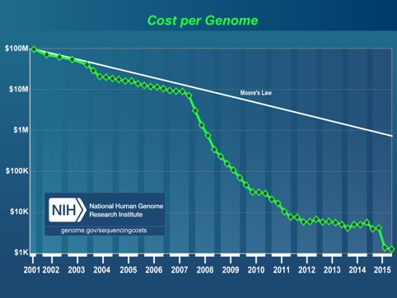
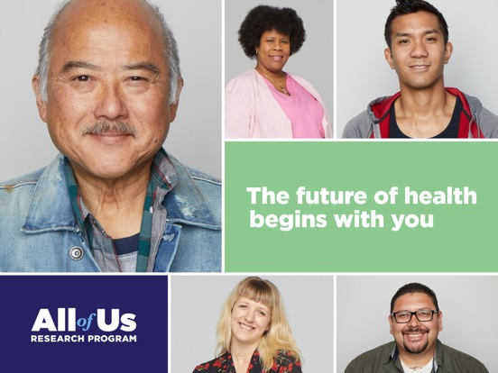
Why Bioinformatics?
The cost of sequencing has rapidly decreased over the past decade, hitting the “$1000 genome.”
The NIH “All of us” Initiative has made it a goal to sequence 1 million genomes, each with ~3 billion nucleotides.
Sequencing of more individuals can help humanity in several ways.
Better understanding of disease causes and risks.
Better understanding of diversity and responses to medicine.
A genetic window into human history– when various populations migrated to different areas and/or re-integrated.
Notes:
But all of that just refers to a single human genome. What if you want to analyze more than one human genome?
We’ve recently passed the “$1000 genome” threshold, meaning that genome sequencing is becoming more and more common– and will continue to do so. Related to that, the NIH has recently launched the “All of Us” initiative, whose goal is to sequence 1 million human genomes.
This is an important goal for many reasons. It helps us have a better understanding of which genomic variants cause or influence disease. It helps us better understand human diversity and, for instance, human responses to medicine, or how disease risk is influenced by your genetic background. It can also give us a window into human history.
All of these goals require processing enormous amounts of information, and require bioinformatics.

Slide 17
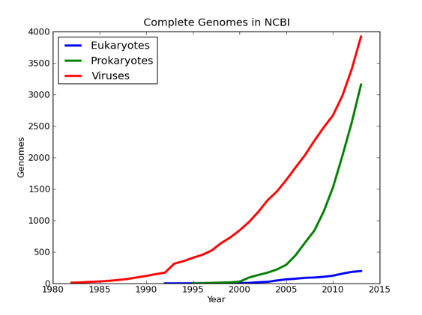
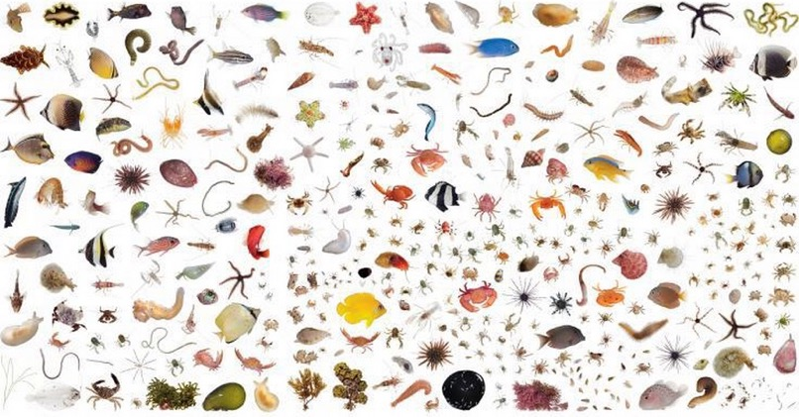
Why Bioinformatics?
~10,000 different species have sequenced genomes.
But there are an estimated 8.7 million species on the planet
Better understanding of molecular evolution
Potential sources of medicine
Implications for conservation efforts
Better understanding of what genetic elements can help species to survive in difficult environments.
Notes:
If you want to look outside of just humans, there are enormous numbers of species. Estimated to be 8.7 million different species (fun fact: only about 5000 of those species are mammals). Sequencing their genomes can offer a ton of insight– understanding molecular evolution. Potential sources of medicine, or disease processes. Potential implications for conservation efforts. Understanding how organisms can survive diverse or difficult environments. Again, understanding these things requires the processing of huge amounts of data, which requires bioinformatics.

Slide 18
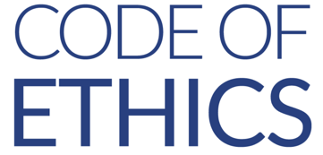
Why Bioinformatics?
These problems can’t be solved by hand. Computational approaches are necessary to analyze enormous amounts of biological data.
There are ethical and social areas in which bioinformatics plays a key role (but not alone).
if ( action != ethical ) {
print(“Don’t do that!”)
}
Notes:
All of these issues require processing huge amounts of data, which requires bioinformatics. But bioinformatics issues don’t just have to do with solving technical problems. There are also ethical implications that bioinformatics plays a role, along with other areas. I want to talk about how bioinformatics intersects with social and ethical issues.

Slide 19
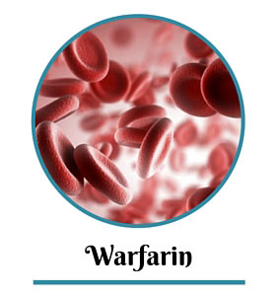
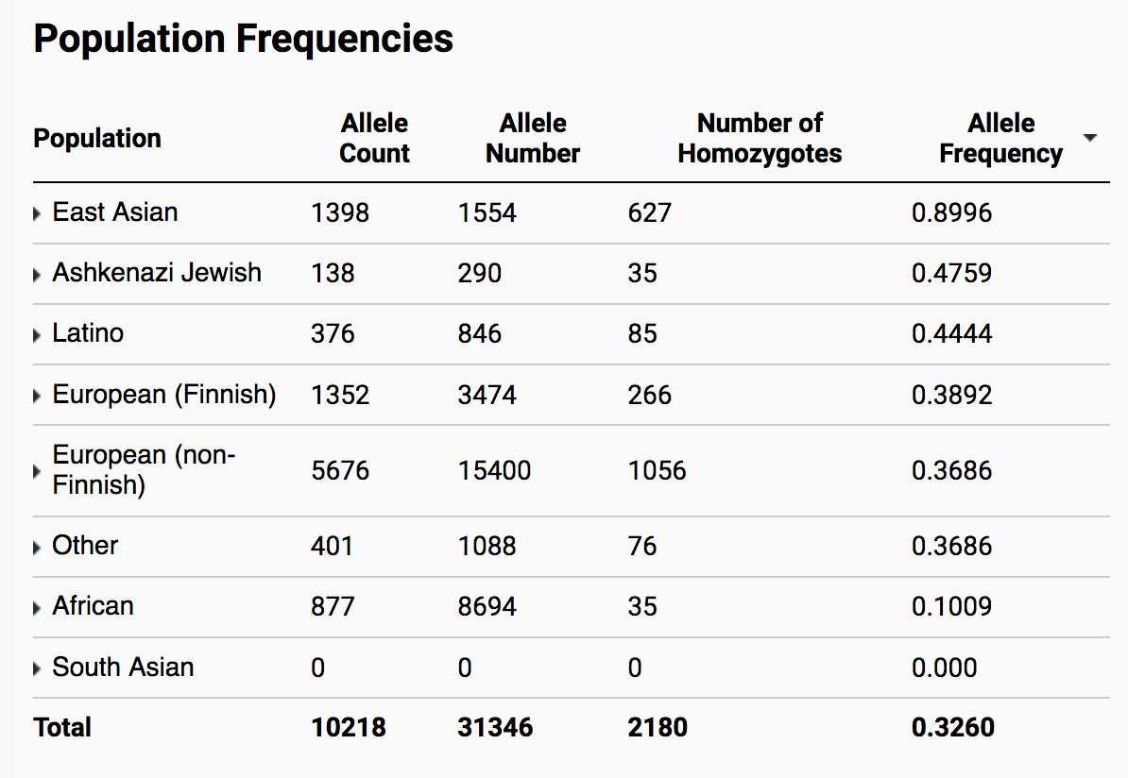
Representation
For a particular medical finding, how sure can we be that the results are true across different populations? Men and women? Various racial and ethnic groups?
Different genetic background can have implications for the effects of medicine, symptoms of disease.
It’s possible that a variant that is rare in one population is very common in another.
Notes:
One area of interest is representation of diverse communities. Let’s say we have some interesting medical result, but all of our data was derived from Europeans Males. Is that result applicable to females as well? To non-Europeans?
Different groups have different genetic backgrounds, which means that findings might not be identical across groups. One famous example of this is the blood-thinner Warfarin. When used by Europeans, the drug reduced incidence of strokes. However, among the African American community, it lead in several cases to patients bleeding to death. This was because specific variants in this gene, VKORC1, changed sensitivity to the drug. So, using bioinformatics to analyze larger scopes of patient data can help make better medical decisions.

Slide 20
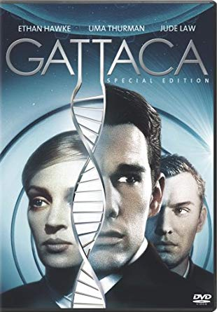

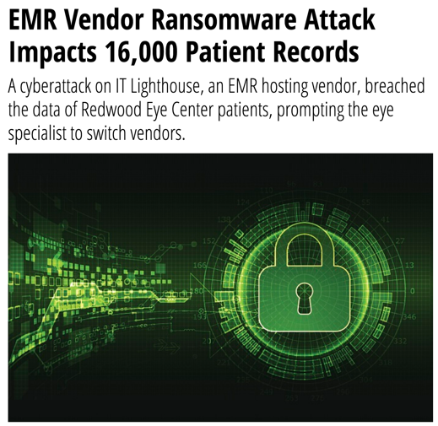
Protection
How can we protect a person’s genetic data?
Who should have access to a person’s genetic data, and how can we help ensure that only those people have access?
Should genetic and medical data be available for research? How can we de-identify information to protect people?
Notes:
Another major area where ethics and bioinformatics overlap is protection, specifically of patient data. Some of you might be familiar with this relatively old film, GATTACA. In that world, genetic information was used to discriminate against people who were at higher risk for disease. Now, fortunately, there are laws in place to prevent that kind of official discrimination. But that doesn’t mean that patients are entirely “safe”. You can ask questions like: who should have access to a patient’s data? Should it be just the patient? The patient and any doctor that treats them? Only doctors that the patient specifically approves of? What about family members, who share a fair amount of genetic information with the patient? If you’re adopted, do you have a right to genetic information of your birth parents?
Should genetic information be made available to researchers, and if so, how do you make sure those researchers use the patient’s data ethically? Even if you have an answer to all of these questions, you have to ask– how can you keep patient data secure, so that bad actors can’t access it? We’re seeing a rise in cases where electronic medical records (sometimes including genetic information) are held hostage. What kind of cyber security efforts do we need to take to make sure patient data is kept secure?

Slide 21
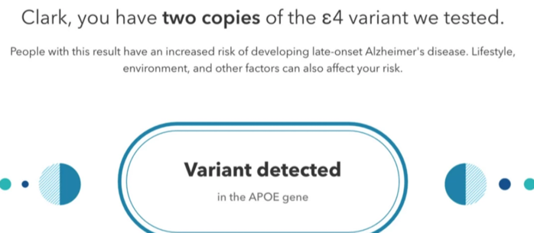
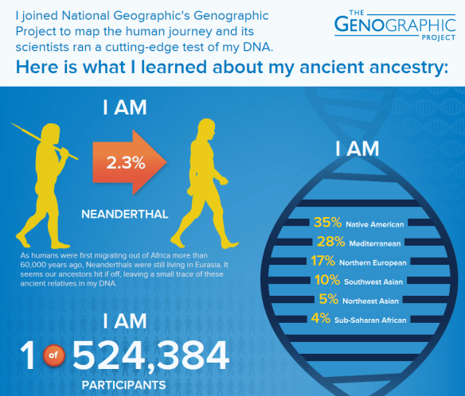
Interpretation of Data
How can we avoid misleading patients or doctors about the interpretation of bioinformatics results?
Disease risk?
Accuracy/interpretation of ancestry estimates?
Notes:
A third area where bioinformatics intersects with ethics is how one interprets data. How can we avoid misleading or scaring patients when we provide them with their data? For instance, let’s say you have this APOE4 allele. This increases your risk of developing Alzheimer’s disease. If you got this result from 23 and me, you might be thinking– oh my god, I’m going to get AD. Should I make a living will? How likely am I to get it?! 100%? 50%? Should I avoid having kids so I don’t pass it on? A little information is a dangerous thing, and we need to think very carefully about what kind of evidence we use to support certain claims. That’s a problem for bioinformatics (among other fields).
A related issue are questions of ancestry, which are becoming more popular. If a test says that you’re 2.3% Neanderthal, what does that mean? Was my great great great grandfather a Neanderthal? (Obviously not…). Or, more importantly, what does it mean to be 35% Native American? And does that have any bearing on your inclusion in that community?

Slide 22
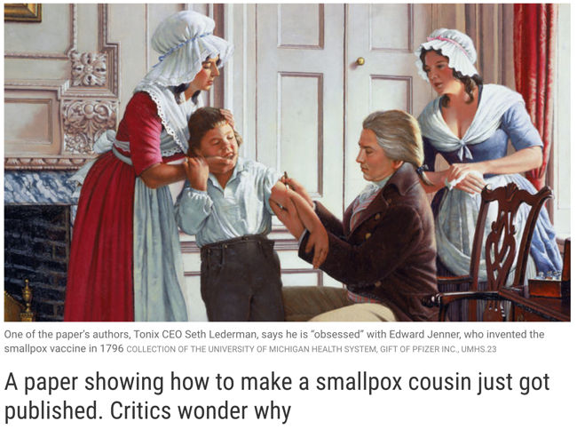
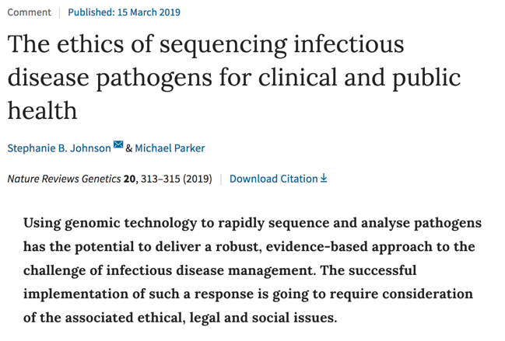
Public Safety
Should we restrict public access to the genome sequences of dangerous organisms?
If so, how can data be stored to both protect the public and still allow research to be performed?
Notes:
I’ll leave you with one last area worth considering: Public safety. Let’s say we have the genome of some very dangerous organism, like Smallpox. Should we make that data publicly available? If not, how can we keep that information safe while still allowing research to be performed and new medical breakthroughs to be developed?

Slide 23
Comp bio in the cooper lab

Slide 24



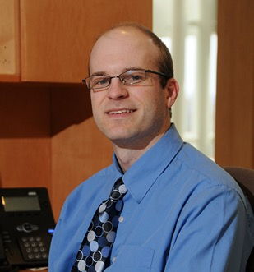

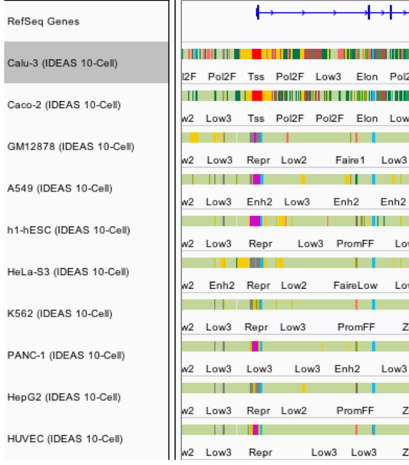
About James Lawlor
B.S.: Biochemistry & Mathematics
M.S.: Modeling & Simulation
Greg Cooper Lab
HudsonAlpha
Computational Biologist
Advisor: Eric
Mendenhall
Notes:
One-minute version of my career path
Got my undergrad degree at UAH, where I knew I wanted to study science and make that into a career path, but wasn’t quite sure which direction I wanted take that
Took a few years to work in industry, doing cost analysis for the DoD
Masters in M&S at UAH:
Worked with Eric Mendenhall and studied the regulation of the CFTR gene
Integrated and optimized several machine learning tools to predict different patterns of CFTR gene regulation in different cell types, with the goal of being able to find enhancers and other genetic elements that cause CFTR to be highly expressed in some types of cells and minimally expressed in others
That opened up the opportunity for me to go work as a Computational Biologist with Greg Cooper’s Lab at HudsonAlpha, where we use genome sequencing to diagnose pediatric rare disease, especially DD/ID
So, I write software and analyze genome sequencing data to help us ask and answer questions about the genetic cause of disease
But how did I get here today? I think that’s fun to point out, because it stems a lot from one of my hobbies, which is patient advocacy for Cystic Fibrosis, which has given me some great opportunities to connect with other adults with CF like myself, including Xan Nowokowski. After Xan and I connected at a CF Foundation virtual event, we began talking about our respective science and research careers, and they were kind enough to bring me here to speak

Slide 25
Why seek genetic diagnoses?
Notes:
* Why seek genetic diagnoses when we are already treating the symptoms of a disorder?

Slide 26
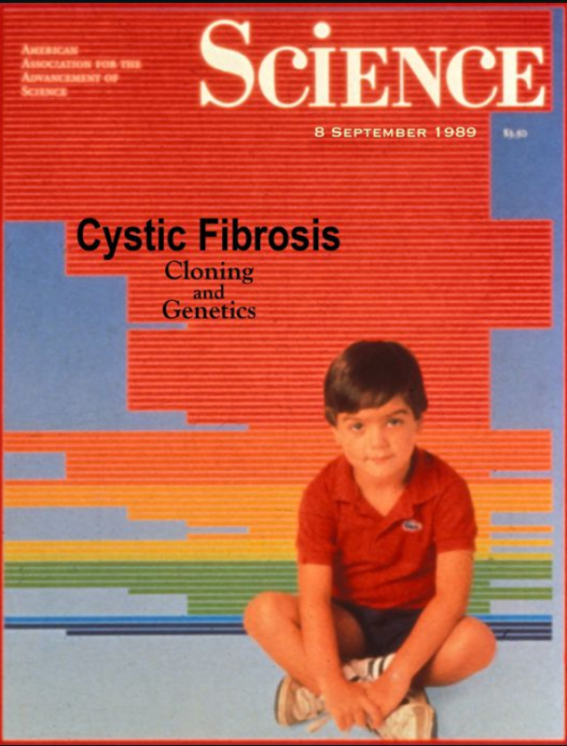
Disease-gene relationships are critical to scientific advancement & treatment
Basic Science: CFTR. (2017). Retrieved from http://www.hopkinscf.org
Notes:
But first I want to pause and reiterate why this basic science that does the work of linking new diseases to genes is so important. In my own life as a CF patient, I’ve been able to witness the direct impact of knowing precisely how a congential disease is affecting the patients on a genetic and molecular level. CFTR, the causative gene for Cystic Fibrosis, was found in 1989, and we eventually learned that it encodes a chloride channel whose malfunction causes the thick mucus that is the hallmark of this disease. This understanding has been critical to a majority of the treatments that I use every day. And that’s why

Slide 27
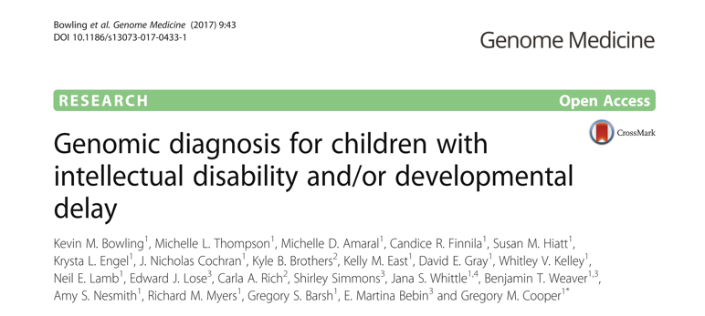
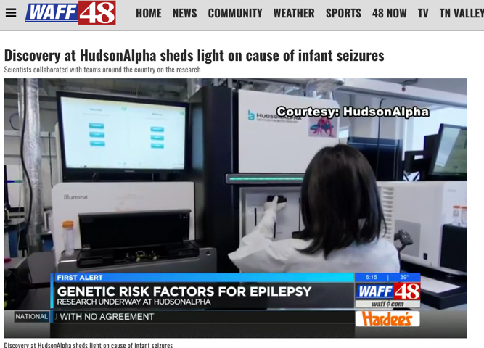
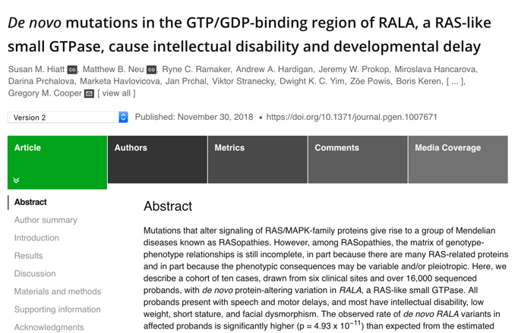
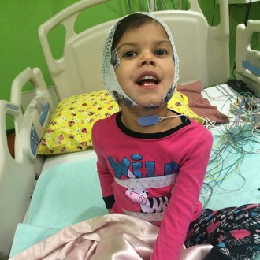
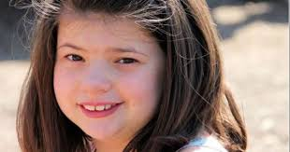
Disease-gene relationships are critical to scientific advancement & treatment

Slide 28
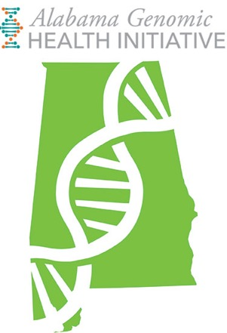

Developmental Delay Diagnosis
Sequence affected individuals + parents
> 800 affected individuals sequenced
Re-analyze cases every ~2 years

Slide 29

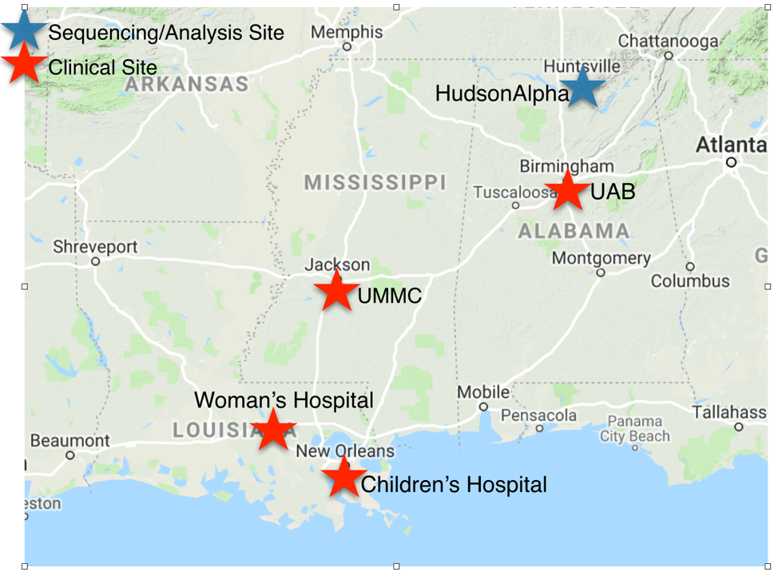
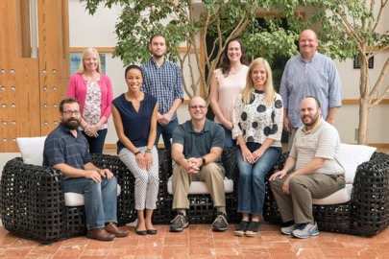
SouthSeq: Genomic Diagnoses for Newborns
Sequence ~1,500 newborns w/ congenital anomalies
Spare patients diagnostic odyssey
Minority / rural focus
Greg Cooper Lab, HudsonAlpha

Slide 30
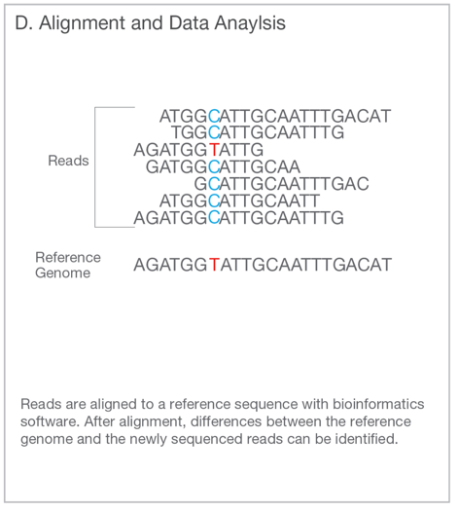
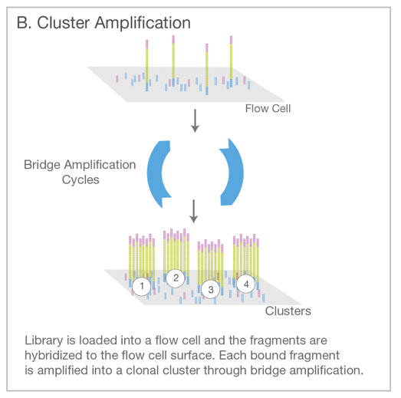
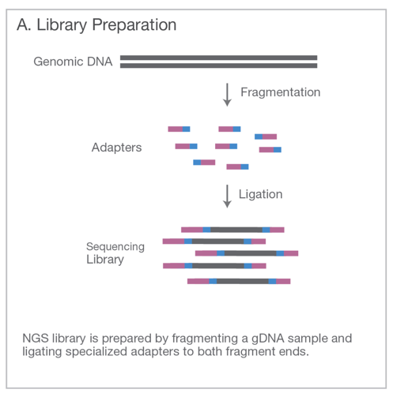
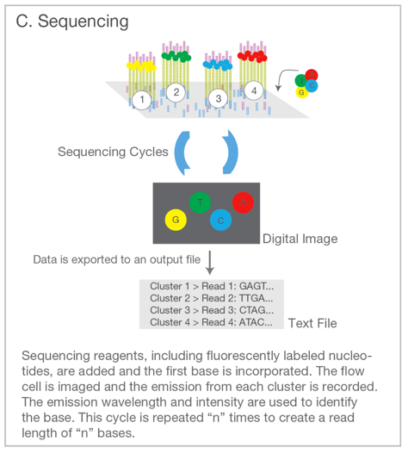
Genome Sequencing (Short Read)
Illumina. An introduction to Next-Generation Sequencing. (2017).

Slide 31
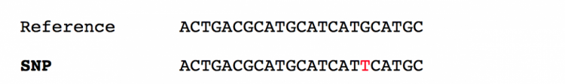
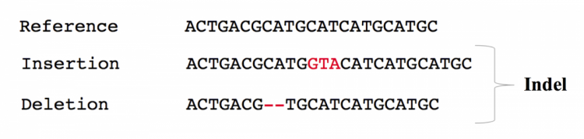
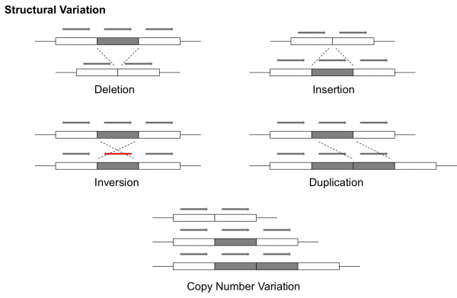
Result: Millions of variants for each person
Each kind of variation requires a different algorithm (or multiple algorithms) to detect from short read data.
EMBL. EMBL-EBI Training (2019).
Notes:
Since our focus is inherited disease, we’re looking at a patient’s DNA

Slide 32
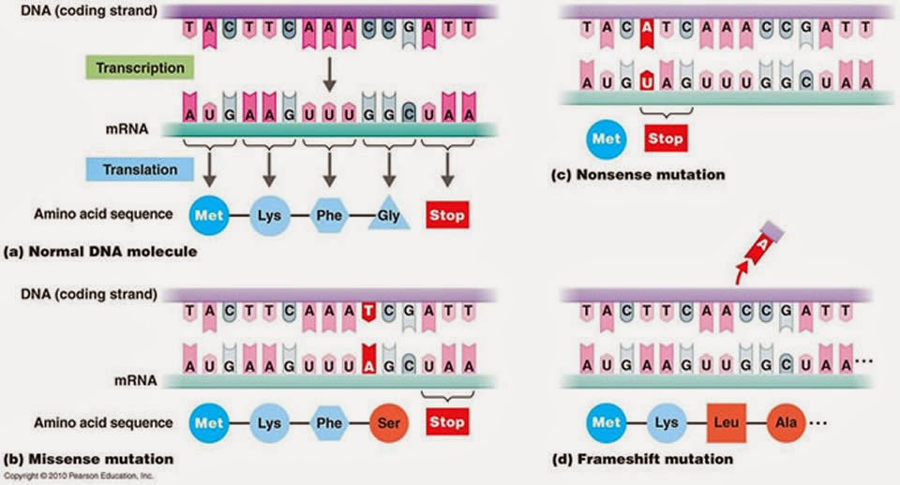
Best-understood variants alter proteins

Slide 33
Filtering / Analysis / Interpretation is key
~4,000,000 variants
population frequency
genomic annotations
computational predictions
inheritance pattern
clinical disease databases
phenotypes
published literature
~1 causal variant
We evaluate the totality of existing evidence for a particular variant

Slide 34
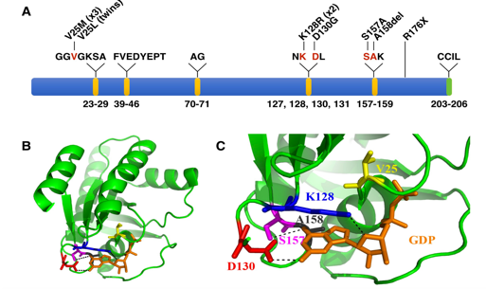
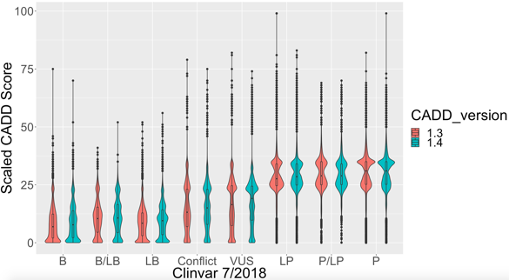
Our Goal: Increase Diagnoses
Describe new disease genes
Analyze more types of variation
Evaluate & improve computational models

Slide 35
Machine Learning

Slide 36
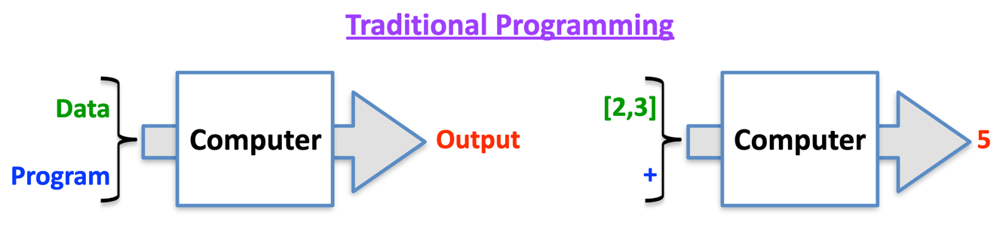
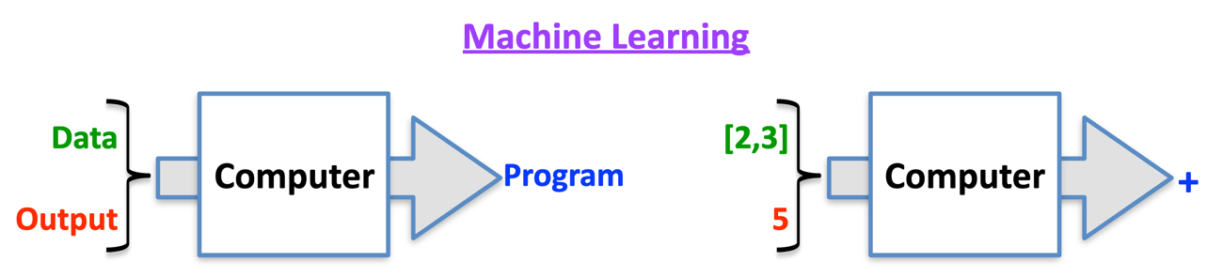
Machine Learning
Data analysis methods to automate analytical model-building
Use data to:
Make predictions
Discover patterns
Useful for complex problems + large amounts of data
Goal: useful not perfect

Slide 37
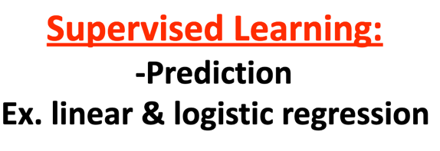
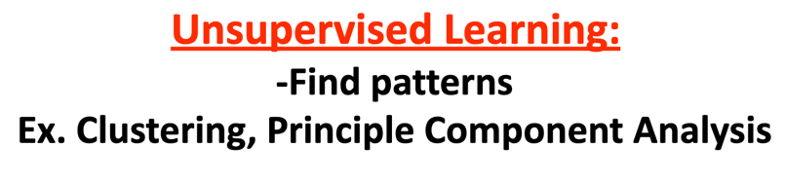
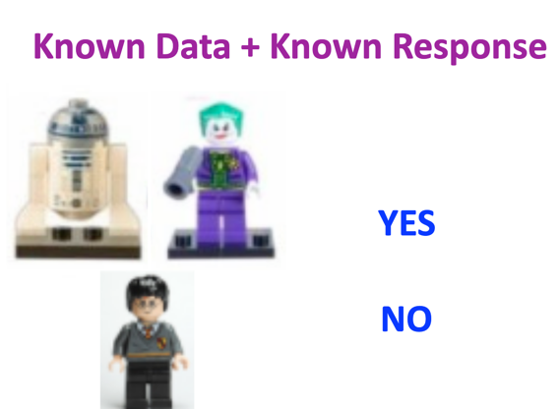
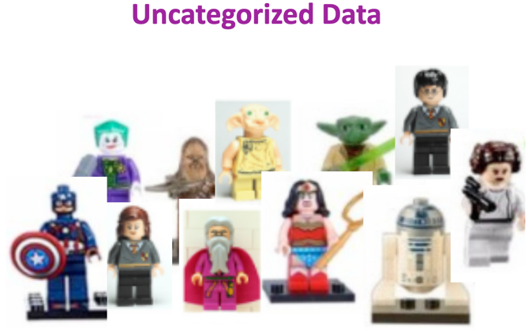




Supervised & Unsupervised Learning

Slide 38
Example: CADD
CADD – Combined Annotation Dependent Depletion

Slide 39


Combined Annotation-Dependent Depletion
CADD:
Predicts deleterious variants
Integrates >100 types of genomic data
Helps prioritize variants
PI: Martin Kircher, PhD
Berlin Institute of Health
Philipp Rentzsch
Notes:
CADD is a computational tool that integrates diverse genomic data to predict deleterious variants.
Published 2014.
We like that it integrates >100 types of genomic data in a reasonably unbiased way. For example, the model includes conservation and protein-coding effects of variants, but it’s not restricted to only dealing with those types of variants.
Deleterious and pathogenic aren’t quite the same thing—deleterious refers to evolutionary fitness and pathogenic refers to clinical disease. But often, the two are strongly correlated and deleteriousness can be a piece of evidence we use in determining if a variant is pathogenic.

Slide 40
Step 1: Use evolutionary biology to find variants harmful to humans

Slide 41

Step 2: Collect Variant Data
>100 annotations, including
Variant effect
Conservation
TFBS Motifs
Biochemical (open chromatin, histone modifications, etc.)
Protein structure
Local SNV Frequencies
Notes:
Variant effect predictions, such as “frameshift” or “regulatory motif disruption”

Slide 42
Step 3: Computational Model
Regression model learns characteristics of harmful variants
Model ranks all possible variants from least deleterious to most deleterious
Convert to score: CADD 10: Top 10th %ile
CADD 20: Top 1st %ile CADD 30: Top 0.1 %ile

Slide 43


Protein-altering variants have high CADD score
CADD Increasing ->

Slide 44
Software development: Codi
Codicem – Genome-scale clinical analysis and interpretation

Slide 45
CODICEM is a variant analysis platform used by several researches at HudsonAlpha
Ingest variants
Annotate with supporting data
Protein effects
Conservation
CADD
Existing disease/gene association
Filter variants
Team variant curation
Report generation
~4,000,000 variants
~1 causal variant

Slide 46
Variants are filtered by their characteristics
,
5,285,977 variants
4,994,771
Sequencing Quality
≥8 reads, ≥15% reads support allele
187,110
Population Frequency
≤ 0.01%
11,468
Predicted Damaging
Affects Protein OR Top 10th %ile CADD
273
Genomic coordinates near a gene
Exclude Intergenic or Unknown Effect
Manual Review:
Inheritance
Literature
Biology
~1
Notes:
Recall, there are 3-5 million variants per person
Show numbers

Slide 47




A small set of high-impact variants is amenable to manual review
PI: Liz Worthey, PhD
Notes:
Analysts review for link to phenotypes

Slide 48

Analysts review filtered variants for potential link to patient’s phenotype

Slide 49





The Challenge
Me
Sequencing lab
Software Developers
Genomic Analyst
Notes:
Me
Sequencing lab
Generates data
Software Developers
Make analysis software
Genomic Analyst
Investigate patient disease & variants

Slide 50

Typical Day
Ask questions:
What can I explore today?
How can I make this process…?
Faster
More reliable
More informative
Evaluate existing tools
Write code
Python
R
Bash
Write about what I did:
For myself
For my collaborators
For the bigger scientific community

Slide 51
Critical Skills
Tech
Science
Communication
Troubleshooting
New languages & tools
Programming
Tech writing
Public speaking
Teamwork
"Translating"
Genetics & Biochemistry
Statistics
Compute clusters
Scientific Literature
Unix
Business Process
Automation
Documentation
Data management

Slide 52
Summary
Bioinformatics skills are critical to providing genetic diagnoses and learning new biology
Genomics requires team science & contributions from diverse skills
The intersection of biology and computational science creates new ethical situations

Slide 53
Bootcamp Intro

Slide 54
Goals
Introduce computational biology through:
Discussion of real-world need for computational skills in genomics
Hands-on lessons from the Software Carpentry in Unix Shell & R
After today, we will be able to:
Navigate files and folders on a Unix system
Create, copy, move, delete, and find files and folders
Record work in a computational lab notebook
Read and manipulate data in the R programming language
Use programming concepts in R: Functions and For Loops
Know where to learn more and how to ask for help

Slide 55
Flow
Discuss concepts -> work exercises -> review together
Website has links to reading/example material: http://james-lawlor.github.io/biotrain-2019
Asking questions = better experience for everyone
Live feedback with post-its:
Green post-it on computer: The pace is good and I’m keeping up
Red post-it on computer: I’d like a helper / Slow down!
Helpers: Experienced helpers are available for one-on-one help as we’re working

Slide 56
Why learn Unix and R?
Unix lets us access high-performance computing environments and industry-standard software
Easy way to introduce fundamental concepts about programming and computers:
Let the computer do the work for you instead of repeating yourself
Save your “program” so you can re-use it later
Learn to combine small tools into a more complex behavior
Learn to troubleshoot problems (of any kind)
A little hands-on experience goes a long way

Slide 57
~ 10 minute Break

